Slide 1

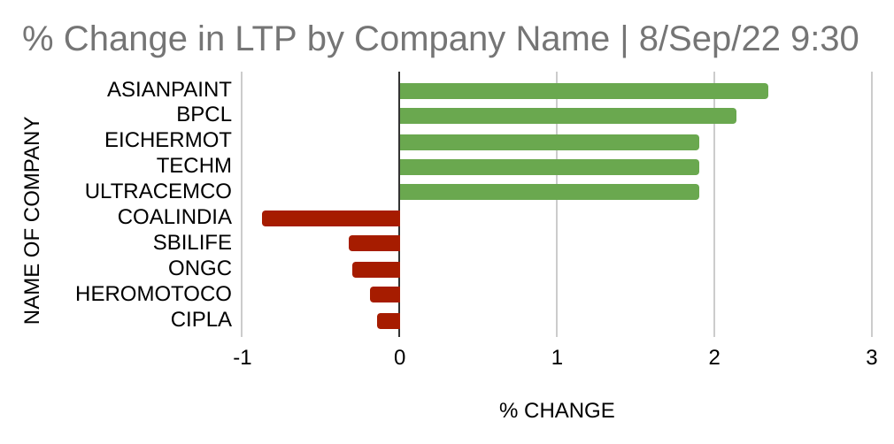
Market Dashboard
Top 10
% Change in LTP of Nifty50
TOP 5 STOCKS - NIFTY 50 - GAINERS AND LOSERS September 8, 2022 | 9:30 a.m.
NAME OF COMPANY | Last Traded Price | % CHANGE | VOLUME
ASIANPAINT | 3,479.85 | 2.34 | 2,46,732
BPCL | 333.85 | 2.14 | 8,22,364
EICHERMOT | 3,447.95 | 1.9 | 96,674
TECHM | 1,075.90 | 1.9 | 3,80,894
ULTRACEMCO | 6,899.35 | 1.9 | 1,22,000
COALINDIA | 236.75 | -0.88 | 12,86,749
SBILIFE | 1,327.20 | -0.33 | 94,726
ONGC | 132.1 | -0.3 | 17,64,098
HEROMOTOCO | 2,849.30 | -0.19 | 25,317
CIPLA | 1,050.00 | -0.14 | 1,45,378
Notes:
Used public data as available on https://www.nseindia.com/
TOP 5 STOCKS - NIFTY 50 - GAINERS AND LOSERS as on September 8, 2022 | 9:30 a.m.
Used Google Sheets to Format and Visualise the data.

